Slide 1
Inheritance
COS 1020 C++ Programming
AUBG COS Department
Based on chapter 10 – C++ for Everyone, Cay Horstmann

Slide 2
Lecture Contents
9.9 Pointers to Objects
10.1 Inheritance Hierarchies
10.2 Implementing Derived Classes
10.3 Overriding Member Functions
10.4 Virtual Functions and Polymorphism

Slide 3
Dynamically Allocating Objects
We can use the new operator to dynamically create objects of primitive as well as user-defined types:
int* pNum = new int(5);
int* pArr = new int[10];
Vehicle* v1 = new Vehicle(1950, 12000, "Red");
NOTE: Always use delete for variables created with new

Slide 4
Using the -> Operator
To access a member on a pointer variable, we could dereference it and use the dot operator:
  cout << (*v1).getPrice() << endl;
Or alternatively, the -> operator:
cout << v1->getColor() << endl;
cout << v1->getPrice() << endl;

Slide 5
Object-oriented Principles
Main concepts:
  Encapsulation
  Abstraction
  Inheritance
  Polymorphism

Slide 6
Object-oriented Principles – Inheritance
Inheritance
  Classes can inherit attributes and behavior from pre-existing classes, called base / super / parent classes
  Child classes can add new functionality and/or override an inherited method
  C++ supports multiple inheritance
  Public inheritance is used to implement an is-a relationship
  Private inheritance (even public members of the base class remain hidden) is used to implement a has-a relationship

Slide 7
Inheritance Hierarchies
Inheritance is the mechanism to conveniently derive a new user-defined type from an existing user-defined type, such that the derived class reuses the existing code
Used to model an IS-A relationship
  The derived class is a variation of the base class
A derived class is developed by adding to and/or altering code of the base class

Slide 8
Inheritance Hierarchies (continued)
By using inheritance, we can create a hierarchy of related types that share the same code and interface
Examples:
  A Circle IS-A Shape, a Car IS-A Vehicle
  An Ellipse IS-NOT-A Circle
  We can extend Car to other classes like:
    ForeignCar IS-A Car, DomesticCar IS-A Car and so on
IS-A relationships are transitive
  If X IS-A Y and Y IS-A Z, then X IS-A Z

Slide 9
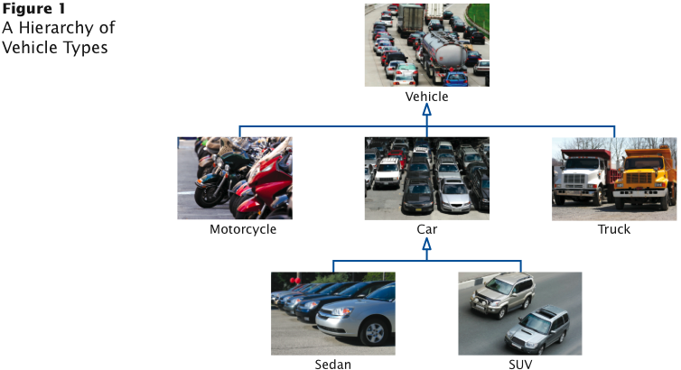
Example: A Class Hierarchy

Slide 10
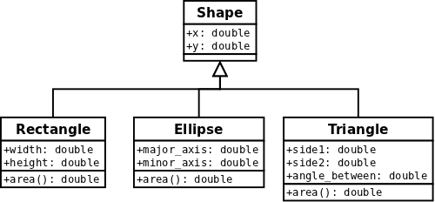
Example: Another Class Hierarchy

Slide 11
HAS-A Relationships
Another type of class relationship is the HAS-A relationship (or IS-COMPOSED-OF)
  The derived class has an instance of the base class
Example:
  Car HAS-A SteeringWheel
Generally, HAS-A relationships should not be modelled by using inheritance (private inheritance)
Instead, they should be modeled with a technique called composition, where components are made private fields

Slide 12
Implementing Derived Classes
Class inheritance syntax:
class Derived : public BaseClass
{
public:
// New and changed member functions
protected:
// Available to child classes only
private:
// Additional data members
};

Slide 13
Public Inheritance Visibility Rules
Base Class | Derived Class
public | public
protected | protected
private | (inaccessible)

Slide 14
Types of Inheritance
class Circle : public Shape, protected Rectangle, Test {
};
Base Class members access modifier | Public | Protected | Private
Public | Public | Protected | Private
Protected | Protected | Protected | Private
Private | (Not Accessible) | (Not Accessible) | (Not Accessible)

Slide 15
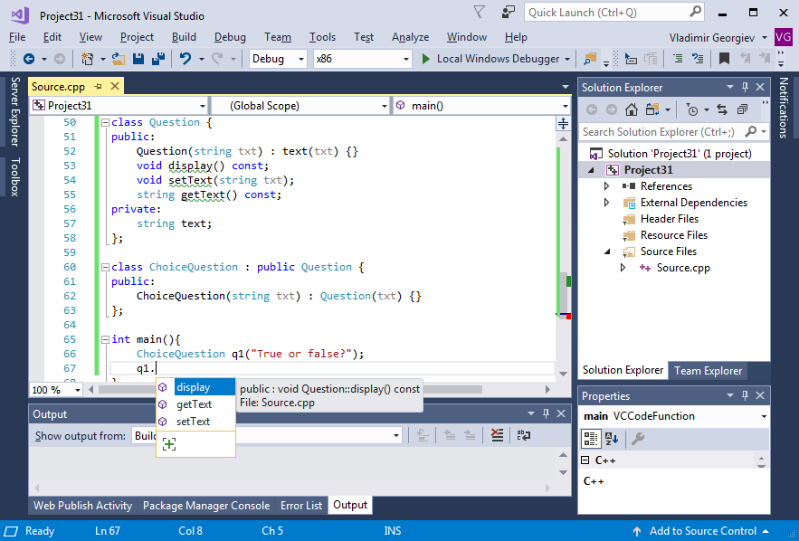
Example: Inheritance in Action

Slide 16
Calling the Base Class Constructor
Unless specified otherwise, base class data members are initialized by calling the default constructor of the base class
To call another base-class constructor from the derived class constructor, use the initializer list:
class ChoiceQuestion : public Question {
public:
ChoiceQuestion(string txt) : Question(txt) {}
};

Slide 17
Overriding Member Functions
We can override (provide different functionality of) a method from the base class in the derived class by providing a derived class method with the same signature
Sometimes we want the derived class method to invoke the base class method to augment it, rather than doing something different
This is known as partial overriding
The scope operator is used to call a base class method

Slide 18
Example: Partial Overriding
class Worker
{
public:
void doWork() {
cout << "Working…" << endl;
}
void drinkCoffee() {
cout << "Coffee…" << endl;
}
};
class HardWorker : public Worker
{
public:
void doWork() {
// note the Worker:: prefix
Worker::doWork();
drinkCoffee();
Worker::doWork();
}
};

Slide 19
Questions?
Q & A

Slide 20
Is This Correct? What Will be Printed?
class Shape {
private:
string color;
public:
Shape() { color = “red”; }
void display() {
cout << color;
}
};
class Circle : Shape {
};
Circle c;
c.display();
display is private method, because we have used private inheritance

Slide 21
Is This Correct? What Will be Printed?
class Shape {
private:
string color;
public:
Shape() { color = “red”; }
void display() {
cout << color;
}
};
class Circle : Shape {
public:
void test() {
display();
}
};
Circle c;
c.test();
red
test() is public function that invokes private one, so ok

Slide 22
Is This Correct? What Will be Printed?
class Shape {
private:
string color;
public:
Shape(string c) { color = c; }
void display() {
cout << color;
}
};
class Circle : public Shape {
};
Circle c;
c.display();
Error! No default constructor!

Slide 23
Is This Correct? What Will be Printed?
class Shape {
private:
string color;
public:
Shape(string c) { color = c; }
void display() {
cout << color;
}
};
class Circle : public Shape {
public:
Circle() : Shape(“green”) {}
};
Circle c;
c.display();
green
OK.

Slide 24
Object-oriented Principles – Polymorphism
Polymorphism
  Having some code behave differently in various contexts
  The ability of a function to behave differently based on the object it is applied to, or its argument list
  For example, a variable can reference objects of several different types (a base class type). When operations are applied on that variable, the operation appropriate to the referenced object is automatically selected

Slide 25
Inheritance and Polymorphism
Inheritance allows the derivation of classes from a base class without disturbing the base class implementation
A derived class is a completely new class that inherits the properties, public methods and implementations of the class from which it was derived
Therefore, a derived class is type compatible with its base class

Slide 26
Inheritance and Polymorphism (continued)
We can have a variable reference objects of several different types
  A variable with a base class type can also store instances of classes that derive from that base class
When operations are applied on that variable, the operation appropriate to the referenced object can be automatically selected at run time
This is known as dynamic binding and is not the default action in C++ - requires some additional code to enable

Slide 27
Base Class and Child Class Objects
Consider the Vehicle, Car and Bus classes from last time:
Vehicle veh(1900, 5000, "Red");
Car car(2400, 6999, "Blue", "Mitsubishi");
veh = car; // OK – we can assign instance of a
// child class to a base class object
car = veh; // ERROR: invalid assignment

Slide 28
Example: Function Override
void Vehicle::display() const {
cout << "Volume: " << volume << endl;
cout << "Price: " << price << endl;
cout << "Color: " << color << endl;
}
void Car::display() const {
Vehicle::display();
cout << "Model: " << model << endl;
}
void Bus::display() const {
Vehicle::display();
cout << "Seats: " << seats << endl;
}

Slide 29
What will the result from the code?
Vehicle veh(1900, 5000, "Red");
Car car(2400, 6999, "Blue", "Mitsubishi");
veh = car;
veh.display();
car.display();

Slide 30
Polymorphism – Simple Scenario
Vehicle* shop[3];
shop[0] = new Vehicle(1900, 1000, "Red");
shop[1] = new Car(2400, 6999, "Blue", ”Mitsubishi");
shop[2] = new Bus(6000, 9000, "Orange", 49);
for (int i = 0; i < shop.size(); i++) {
shop[i]->display();
cout << endl;
}

Slide 31
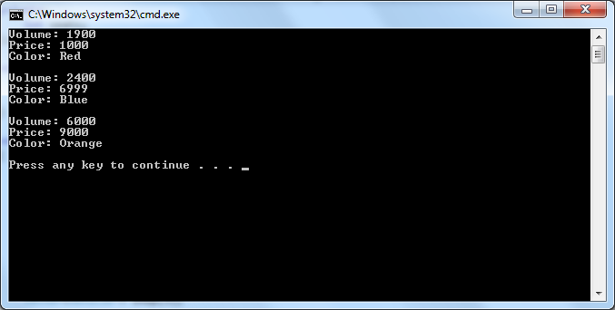
Problem: display() on Base Class Called
Because the display() method is called on an object of type Vehicle, the overridden methods of the real objects are not called

Slide 32
Solution: Using Virtual Functions
class Vehicle {
public:
...
virtual void display() const;
...
};

Slide 33
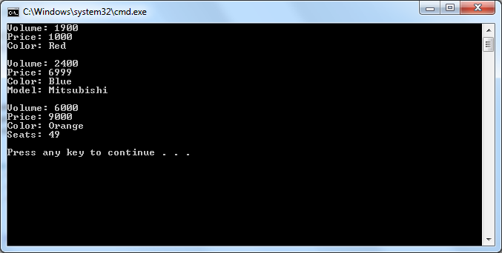
Correct Instance of display() Called

Slide 34
Virtual Functions
If a member function is declared virtual, dynamic binding is used
The decision which function to use to resolve an overload is made at runtime (if it cannot be determined at compile time)
As a general rule, if a function is overridden in a derived class, it should be declared virtual in the base class to ensure that the correct function is selected
However, a run-time decision is needed only when an object is accessed through a pointer or reference to a base class

Slide 35
Another Polymorphism Example
class Person {
public:
// the virtual keyword is needed
// for dynamic binding and
// polymorphism for that method
virtual void print() {
cout << "Person" << endl;
}
};
class Employee : public Person {
public:
void print() {
cout << "Employee" << endl;
}
};
#include <iostream>
using namespace std;
void output(Person& p)
{
p.print();
}
int main()
{
Person per;
Employee emp;
output(emp);
output(per);
return 0;
}

Slide 36
Abstract Methods and Classes
An abstract method has no definition in the base class and has to be defined in a derived class
An abstract method is also known as a pure virtual function in C++ and declared as:
  virtual double area() const = 0;
A class that has at least one abstract method is called an abstract class
Abstract classes cannot be instantiated

Slide 37
Example
class Shape {
private:
string color;
bool filled;
public:
Shape(string c, bool f);
virtual double getArea() const = 0;
};
class Circle : public Shape {
private:
double radius;
const double PI = 3.14;
public:
Circle(string c, bool f, double r);
double getArea() const;
};

Slide 38
Example (continued)
class Rectangle : public Shape {
private:
double width, height;
public:
Rectangle(string c, bool f, double w, double h);
double getArea() const;
};
int main() {
Shape* shapes[2];
shapes[0] = new Circle("green", true, 10);
shapes[1] = new Rectangle("green", true, 10, 5);
for (int i = 0; i < 2; ++i) { cout << shapes[i]->getArea() << endl; }
for (int i = 0; i < 2; ++i) { delete shapes[i]; }
return 0;}}

Slide 39
Summary of Member Function Types
Nonvirtual functions – overloading is resolved at compile time. Used when a method is never redefined in a derived class
Virtual functions – overloading is resolved at run time. The base class provides a default implementation that can be overridden by subclasses
Pure virtual functions – overloading is resolved at run time. The base class provides no implementation and requires that subclasses to either provide one, or be abstract themselves

Slide 40
Which of Those Are Correct?
Suppose class Derived inherits publicly the abstract class Base. Which of the following are valid:
Base* b = new Derived(); // classic polymorphism
Derived *d = new Base(); // cannot instantiate Base
Derived *d = new Derived(); // normal behavior
Base* b = new Base(); // cannot instantiate Base

Slide 41
What Will be Displayed?
class Character {
public:
void display() const {
cout << “Character" << endl;
}
};
Character // static binding occurs
class Thor : public Character {
public:
void display() const {
cout << "Thor" << endl;
}
};
void main()
{
Character* c = new Thor();
c->display();
}

Slide 42
What Will be Displayed?
class Book {
public:
void display() {
cout << "I am a book" << endl;
}
};
I am book // not virtual in base
class Textbook : public Book {
public:
virtual void display() {
cout << "I am a textbook" << endl;
}
};
void main()
{
Book* book = new Textbook();
book->display();
}

Slide 43
What Will be Displayed?
class Character {
public:
virtual void display() const {
cout << “Character" << endl;
}
};
Character // different signatures
class Thor : public Character {
public:
void display(){
cout << "Thor" << endl;
}
};
void main()
{
Character* c = new Thor();
c->display();
}

Slide 44
What Will be Displayed?
class Character {
public:
virtual void display() const {
cout << “Character" << endl;
}
};
Thor
class Thor : public Character {
public:
void display() const{
cout << "Thor" << endl;
}
};
void main()
{
Character* c = new Thor();
c->display();
}

Slide 45
Questions?
Q & A

